Slide 1
Lead-Score case study
By:-
Pranav Vikas Nagaonkar

Slide 2
Path Followed
Data Preparation and Transformation
1. Duplicate Handling: Identify and remove duplicate records.
2. Missing Value Treatment: Address NA and missing values effectively.
3. Column Pruning: Eliminate columns with extensive missing data or those irrelevant to analysis.
4. Imputation: Substitute missing values where necessary.
5. Outlier Management: Detect and treat outliers in the dataset.
Exploratory Data Analysis (EDA)
1. Univariate Analysis: Examine single variables through value counts and distribution patterns.
2. Bivariate Analysis: Explore relationships between pairs of variables using correlation coefficients and pattern analysis.
Feature Engineering
1. Scaling: Apply feature scaling techniques.
2. Encoding: Create dummy variables and encode categorical data.
Model Development
1. Classification Method: Utilize logistic regression for model building and prediction.
2. Model Validation: Assess the model's performance through appropriate validation techniques.
Model Reporting
1. Presentation: Prepare and present the model findings.
2. Insights and Recommendations: Draw conclusions and provide actionable recommendations based on the model results.

Slide 3
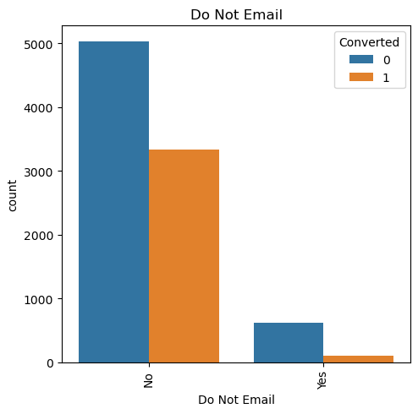
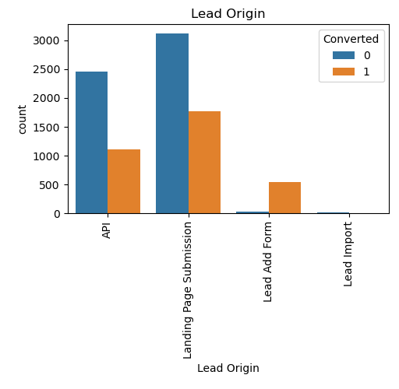
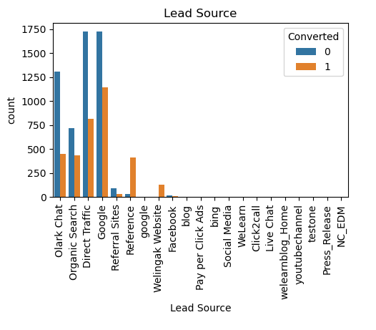
EDA

Slide 4
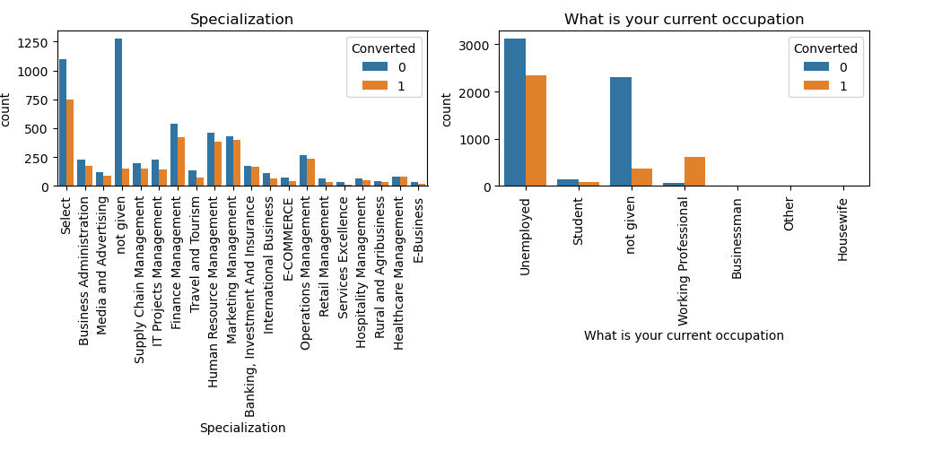
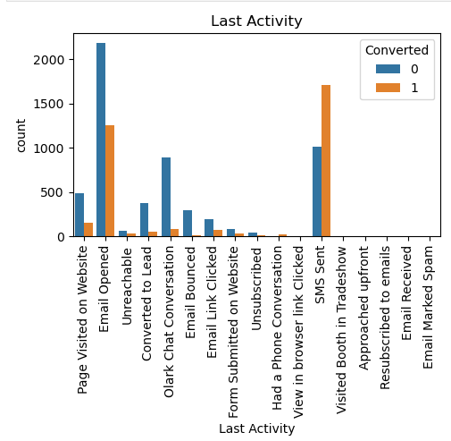

Slide 5
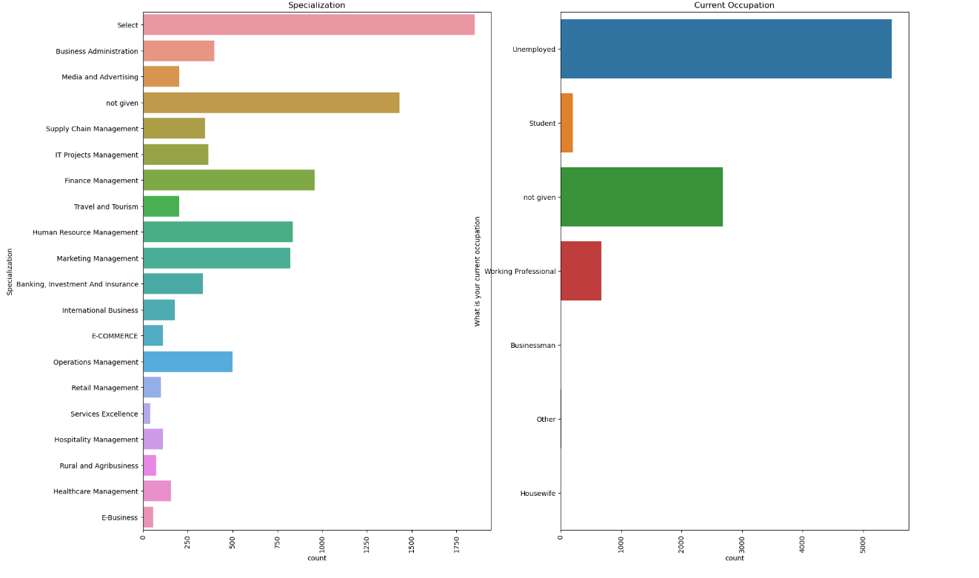

Slide 6
Model Building
Data Splitting
1. Train-Test Split: Divide the data into training and testing sets in a 70:30 ratio, a fundamental step for regression analysis.
Feature Selection
1. RFE Implementation: Use Recursive Feature Elimination (RFE) to select features, targeting 15 variables.
2. Variable Pruning: Remove variables with p-values greater than 0.05, VIF values exceeding 5.
Model Development
1. Model Training: Build the regression model using the selected features.
2. Prediction: Make predictions on the test dataset.
Model Evaluation
1. Accuracy Assessment: Achieve an overall accuracy of 80%.

Slide 7
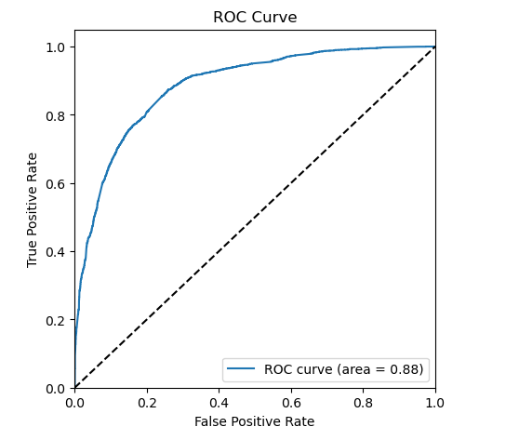
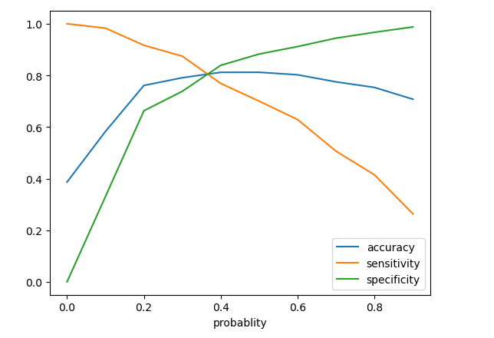
*the optimal cut off is at 0.35.
Roc Curve

Slide 8
Conclusion of the Case Study
KEY INSIGHTS
1. Key Influential Variables:
- Total Time Spent on Website and Total Number of Visits are top indicators of lead conversion.
- Lead Source: Google, direct traffic, organic search, and Welingak website leads convert more.
- Last Activity: SMS and Olark chat conversations strongly indicate conversion.
2. Model Efficiency: -Achieves 80% accuracy.
- Optimum Cut-off: At 0.35, achieves around 79% accuracy, sensitivity, and specificity.
- Precision-Recall Balance: 61% precision and 72% recall.
3. Strategic Recommendations:
- Focus on high-impact variables for marketing efforts.
- Prioritize sales efforts on high lead scores to improve conversion rates.
- Adjust strategies during different phases to optimize resource use.
4. Future Adaptability:
- The model can be refined for future requirements and new data insights.

